Slide 1


DIYALA UNIVERSITY
COLLEGE OF ENGINEERING
DEPARTMENT OF COMMUNICATION ENGINEERING
Electronic Circuits II
Second Year_ Lecture 1
Asst. lecturer
Wisam Hayder
2021

Slide 2
Topics of this course are four chapters:
1. Multistage amplifier: Analysis of multistage amplifiers (voltage gain, current gain, etc.), and types of multistage amplifiers (cascade….etc.).
2. Tuned amplifiers: Transformer- coupled amplifiers; signal- tuned, and tapped and double tuned amplifiers.
3. Introduction to four-layer devices: Description and operation of silicon control rectifier, disc, thirstier, GTO, and triac.
4. Feedback Amplifier, Op-Amp and Application.
Notes:
aaa

Slide 3
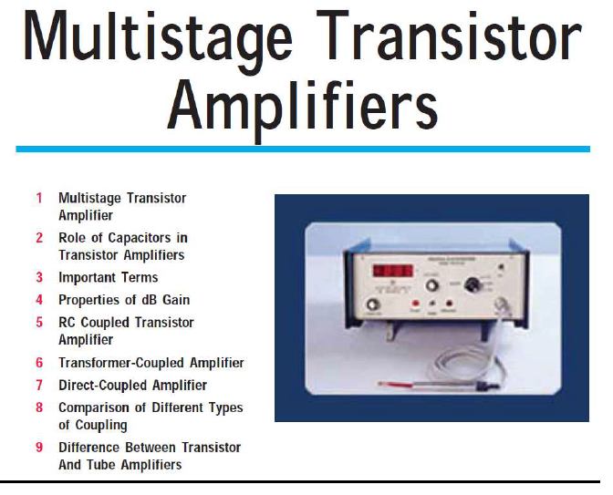
Multistage amplifier
Notes:
aaa

Slide 4
Multistage Transistor Amplifier
Introduction:
The output from a single stage amplifier is usually insufficient to drive an output device.
In other words, the gain of a single amplifier is inadequate for practical purposes.
Consequently, additional amplification over two or three stages is necessary.
To achieve this, the output of each amplifier stage is coupled in some way to the input of the next stage.
Notes:
aaa

Slide 5
Multistage Transistor Amplifier
The resulting system is referred to as multistage amplifier.
It may be emphasized here that a practical amplifier is always a multistage amplifier.
For example, in a transistor radio receiver, the number of amplification stages may be six or more.
In this chapter, we shall focus our attention on the various multistage transistor amplifiers and their practical applications.
Notes:
aaa

Slide 6
Multistage Transistor Amplifier
Depending upon the number of stages of Amplification, there are Single-stage amplifiers and Multi-stage amplifiers.
Single-stage Amplifiers −This has only one transistor circuit, which is a single stage amplification.
Multi-stage Amplifiers −This has multiple transistor circuit, which provides multi-stage amplification.
Notes:
aaa

Slide 7
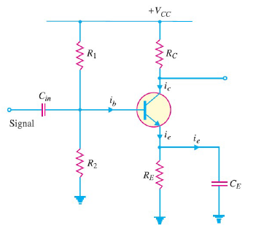
Multistage Transistor Amplifier
Single stage amplifier
Notes:
aaa

Slide 8
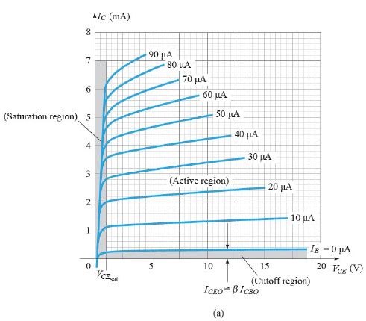
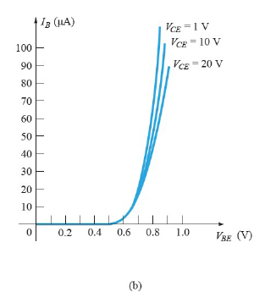
Multistage Transistor Amplifier
Notes:
aaa

Slide 9
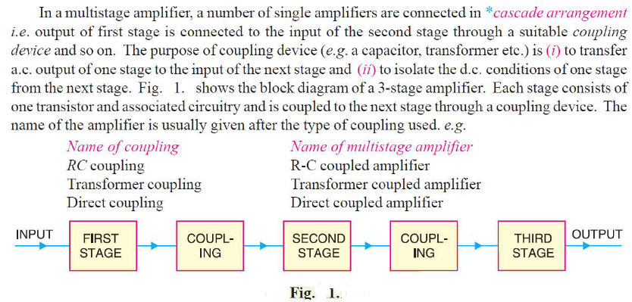
Multistage Transistor Amplifier
1. Multi-Stage Transistor Amplifier:
Notes:
aaa

Slide 10
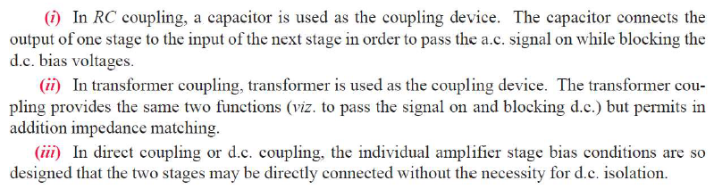
Multistage Transistor Amplifier
Notes:
aaa

Slide 11
Multistage Transistor Amplifier
Classification Of Amplifiers:
Amplifiers are classified in many ways based on different criteria as given below:
I. In terms of frequency range:
1. DC amplifiers. (0 Hz to 20 Hz)
2. Audio amplifiers (20 Hz to 20 KHz)
3. Radio frequency amplifiers (Few KHz to hundreds of KHz)
4. Microwave amplifiers (In the range of GHz)
5. Video amplifiers (Hundreds of GHz)
Notes:
aaa

Slide 12
Multistage Transistor Amplifier
II. In terms of signal strength:
1. Small signal amplifiers.
2. Large signal amplifiers.
III. In terms of coupling:
1. Direct coupling.
2. Resistance – capacitance (RC) coupling.
3. Transformer coupling.
Notes:
aaa

Slide 13
Multistage Transistor Amplifier
IV. In terms of parameter:
1. Voltage amplifiers.
2. Current amplifiers.
3. Power amplifiers.
V. In terms of biasing condition:
1. Class A amplifier
2. Class B amplifier
3. Class AB amplifier
4. Class C amplifier.
Notes:
aaa

Slide 14
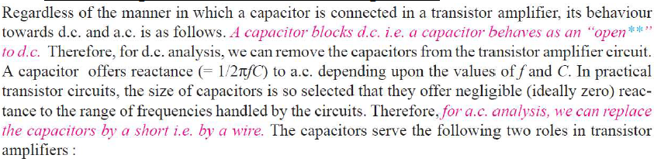
Multistage Transistor Amplifier
VI. In terms of tuning:
1. Single tuned amplifier
2. Double tuned amplifier
3. Stagger tuned amplifier.
2. Role of Capacitors in Transistor Amplifiers:
Notes:
aaa

Slide 15
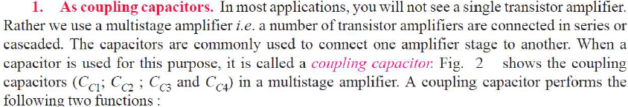
Multistage Transistor Amplifier
Notes:
aaa

Slide 16
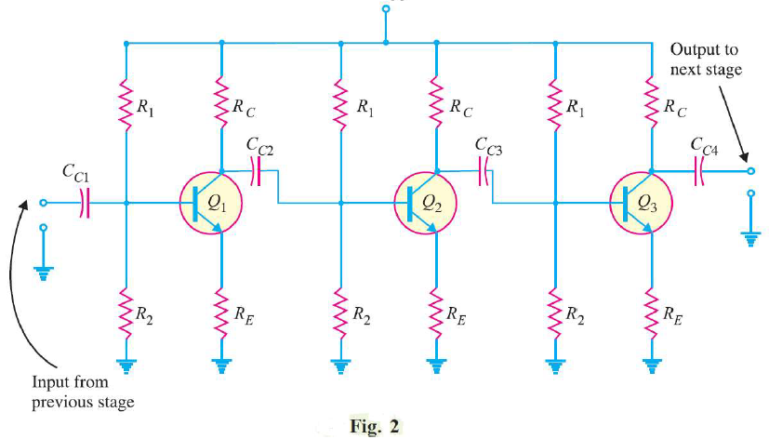

Multistage Transistor Amplifier
Notes:
aaa

Slide 17
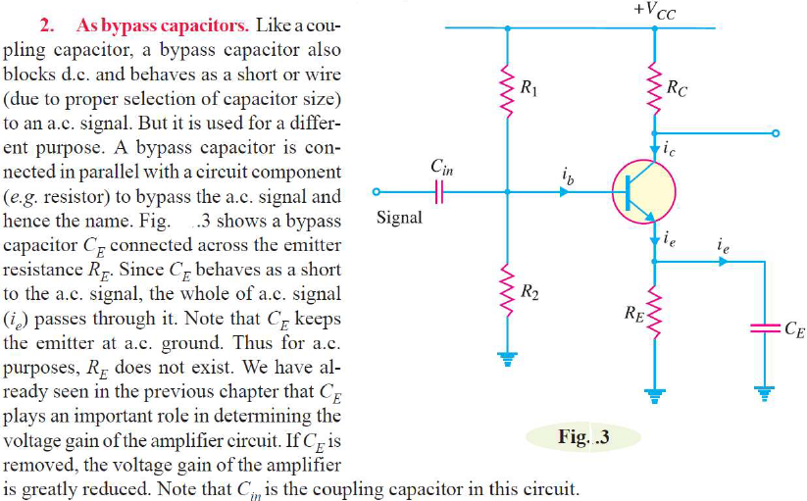
Multistage Transistor Amplifier
Notes:
aaa

